Slide 1

ETL’ing in Alfresco Open Source flavor
Fran Álvarez
Technical Architect

Slide 2


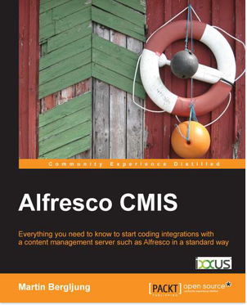
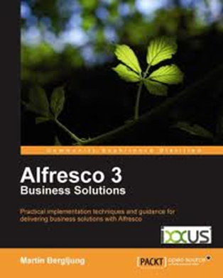
A Global Platinum-level Alfresco partner
Working with Alfresco since Alfresco v0.6
Over 140 Alfresco implementations
Alfresco & WCM Architecture Design Patterns
First worldwide implementation of the first Alfresco WCM product in 2007
Excellent Alfresco knowledge and highly trained and experienced staff
Alfresco Certified Engineers and Alfresco Certified Administrators
Authoring of leading Alfresco books
Alfresco Technical blogs http://www.ixxus.com/blog/
Multiple speaking engagements at the Alfresco Conferences (2011-2014) and Alfresco Days
Alfresco Million $ Club (May 2012) – Only 2 companies awarded
Alfresco Solution Partner of the Year 2013 and 2014
Alfresco Best Solution 2015 and Partner of the Year 2015 (Northern Europe)

Slide 3
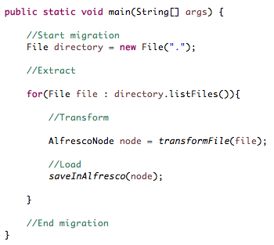
Migration schoolyard approach

Slide 4
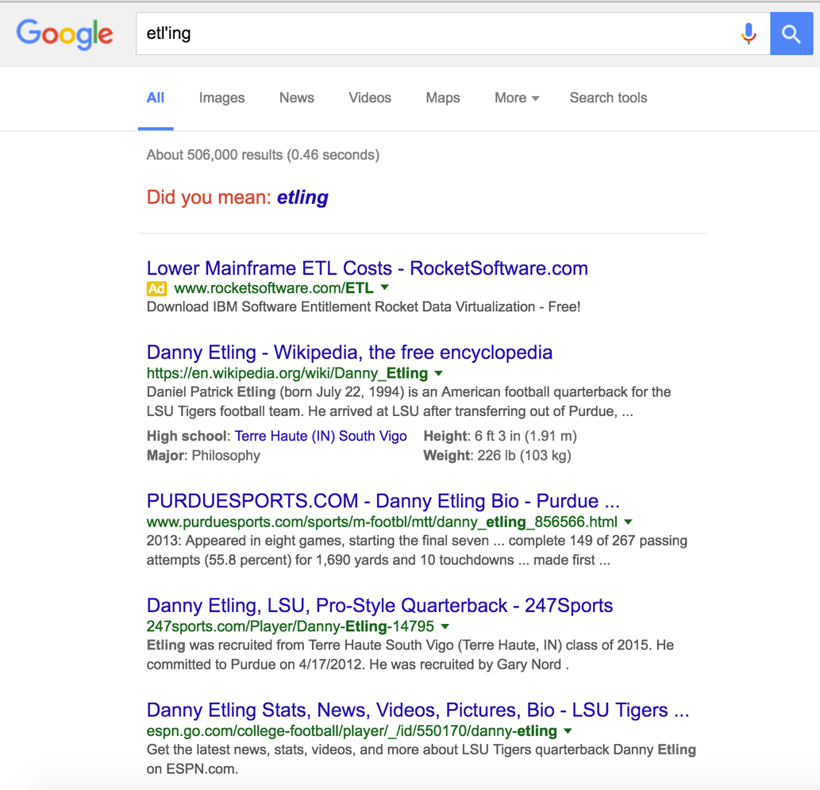
ETL’ing?
No…I just invented the word

Slide 5
ETL
Notes:
Image source:
http://www.dbbest.com/blog/extract-transform-load-etl-technologies-part-1/

Slide 6
ETL
Extract
Transform
Load
File system
SharePoint
OpenText
Database
Bulk Import format
CMIS compliant doc
JSON
Bulk Import
CMIS Ingester
Custom Service

Slide 7
ETL
Sequential?
Transactional?
Synchronous?
Notes:
Image source:
http://www.dbbest.com/blog/extract-transform-load-etl-technologies-part-1/

Slide 8
Common Migration Problems
Managed as a single block
Unable to determine when it went wrong
‘Cross your fingers and pray to God’ approach
Data dependency poorly managed

Slide 9
EIP
See Hohpe & Woolf Enterprise Integration Patterns
Notes:
Image source:
http://www.dbbest.com/blog/extract-transform-load-etl-technologies-part-1/

Slide 10
ETLR
Assumption: No single content will fail in any migration or dry run performed ever

Slide 11
Reporting
What was wrong?
How long did it take?
Fix chunks not whole

Slide 12
ETLRU
Assumption: Migration should be done by some DevOps guru ninja

Slide 13
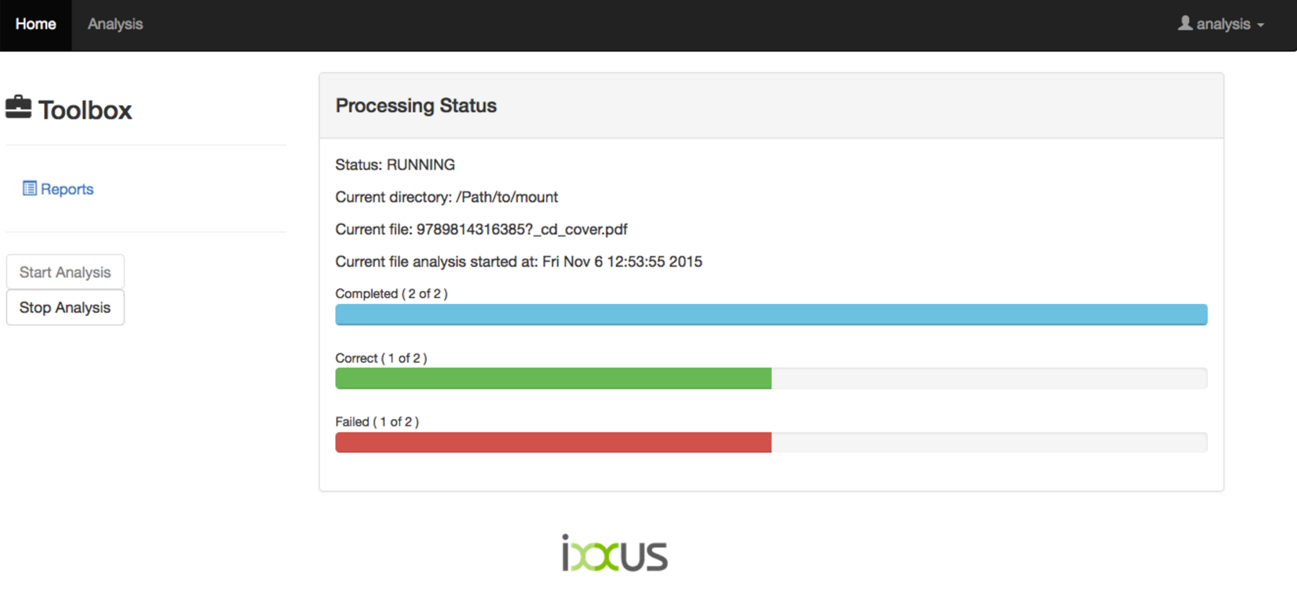
Usability
Single Web App
Easy to use and understand

Slide 15

Tackling the problem
Open Source will always help

Slide 16
Orchestration
Rule-based routing and mediation engine
Implementation of Enterprise Integration Patterns
Java-based
DSL:
Java
XML
Scala

Slide 17
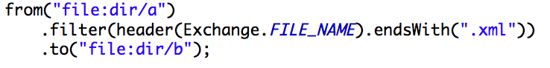
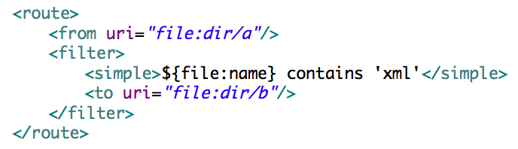
Apache Camel

Slide 18
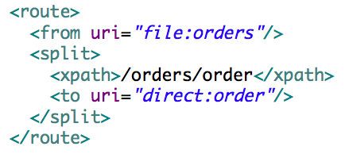
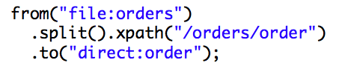
Apache Camel
EIP Implementation (e.g. Splitter)

Slide 19
Apache Camel
Components
from("jms:incoming.orders?transacted=true") .to("jms:topic:events?priority=7") .to("jms:queue:orders?timeToLive=1000");
from("jms:topic:events?clientId=camel&durableSubscriptionName=events”) .to("log:events");
from("quartz:triggered?trigger.repeatCount=10 &trigger.repeatInterval=5000").to("log:quartz");

Slide 20
Extract
Depends a lot on the source
Source exporter connector
CMIS
Custom API
Open Source-ness can’t be guaranteed ☹ but customer will have the blame for that!
Etc.

Slide 21
Transform
Could be skipped when:
Data is extracted in the exact format Load is expecting
No Data dependency

Slide 22
Load
Alfresco Bulk Import
(https://github.com/pmonks/alfresco-bulk-import)
Either ootb or modifications if needed

Slide 23
Report
Log all the information for being consumed later
Logging in a separate route
No-SQL database
JSON-like format
Cross Platform
Store id, status, reason

Slide 24
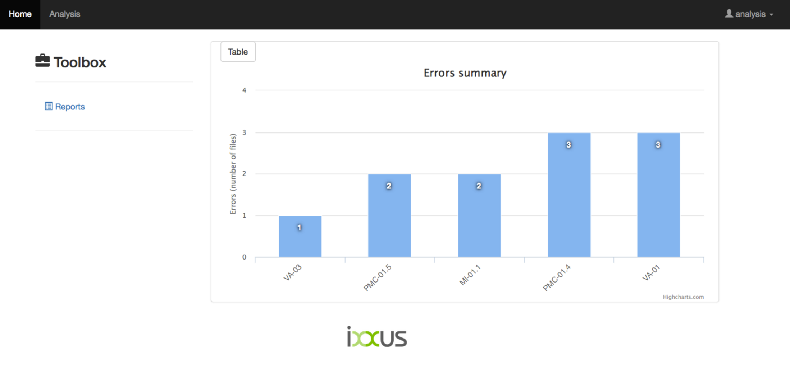
Report

Slide 25
Usability
Wrap everything in a single Web app
Provide UI and API access
Add some nice charts and dashlets
Secure it
Make it easy to deploy

Slide 26
Usability
Stand alone Spring applications
Production based
Spring framework-like
Friendly HTML+JS framework
Easy, Adaptable
Charts JS framework
Easy, adaptable

Slide 27
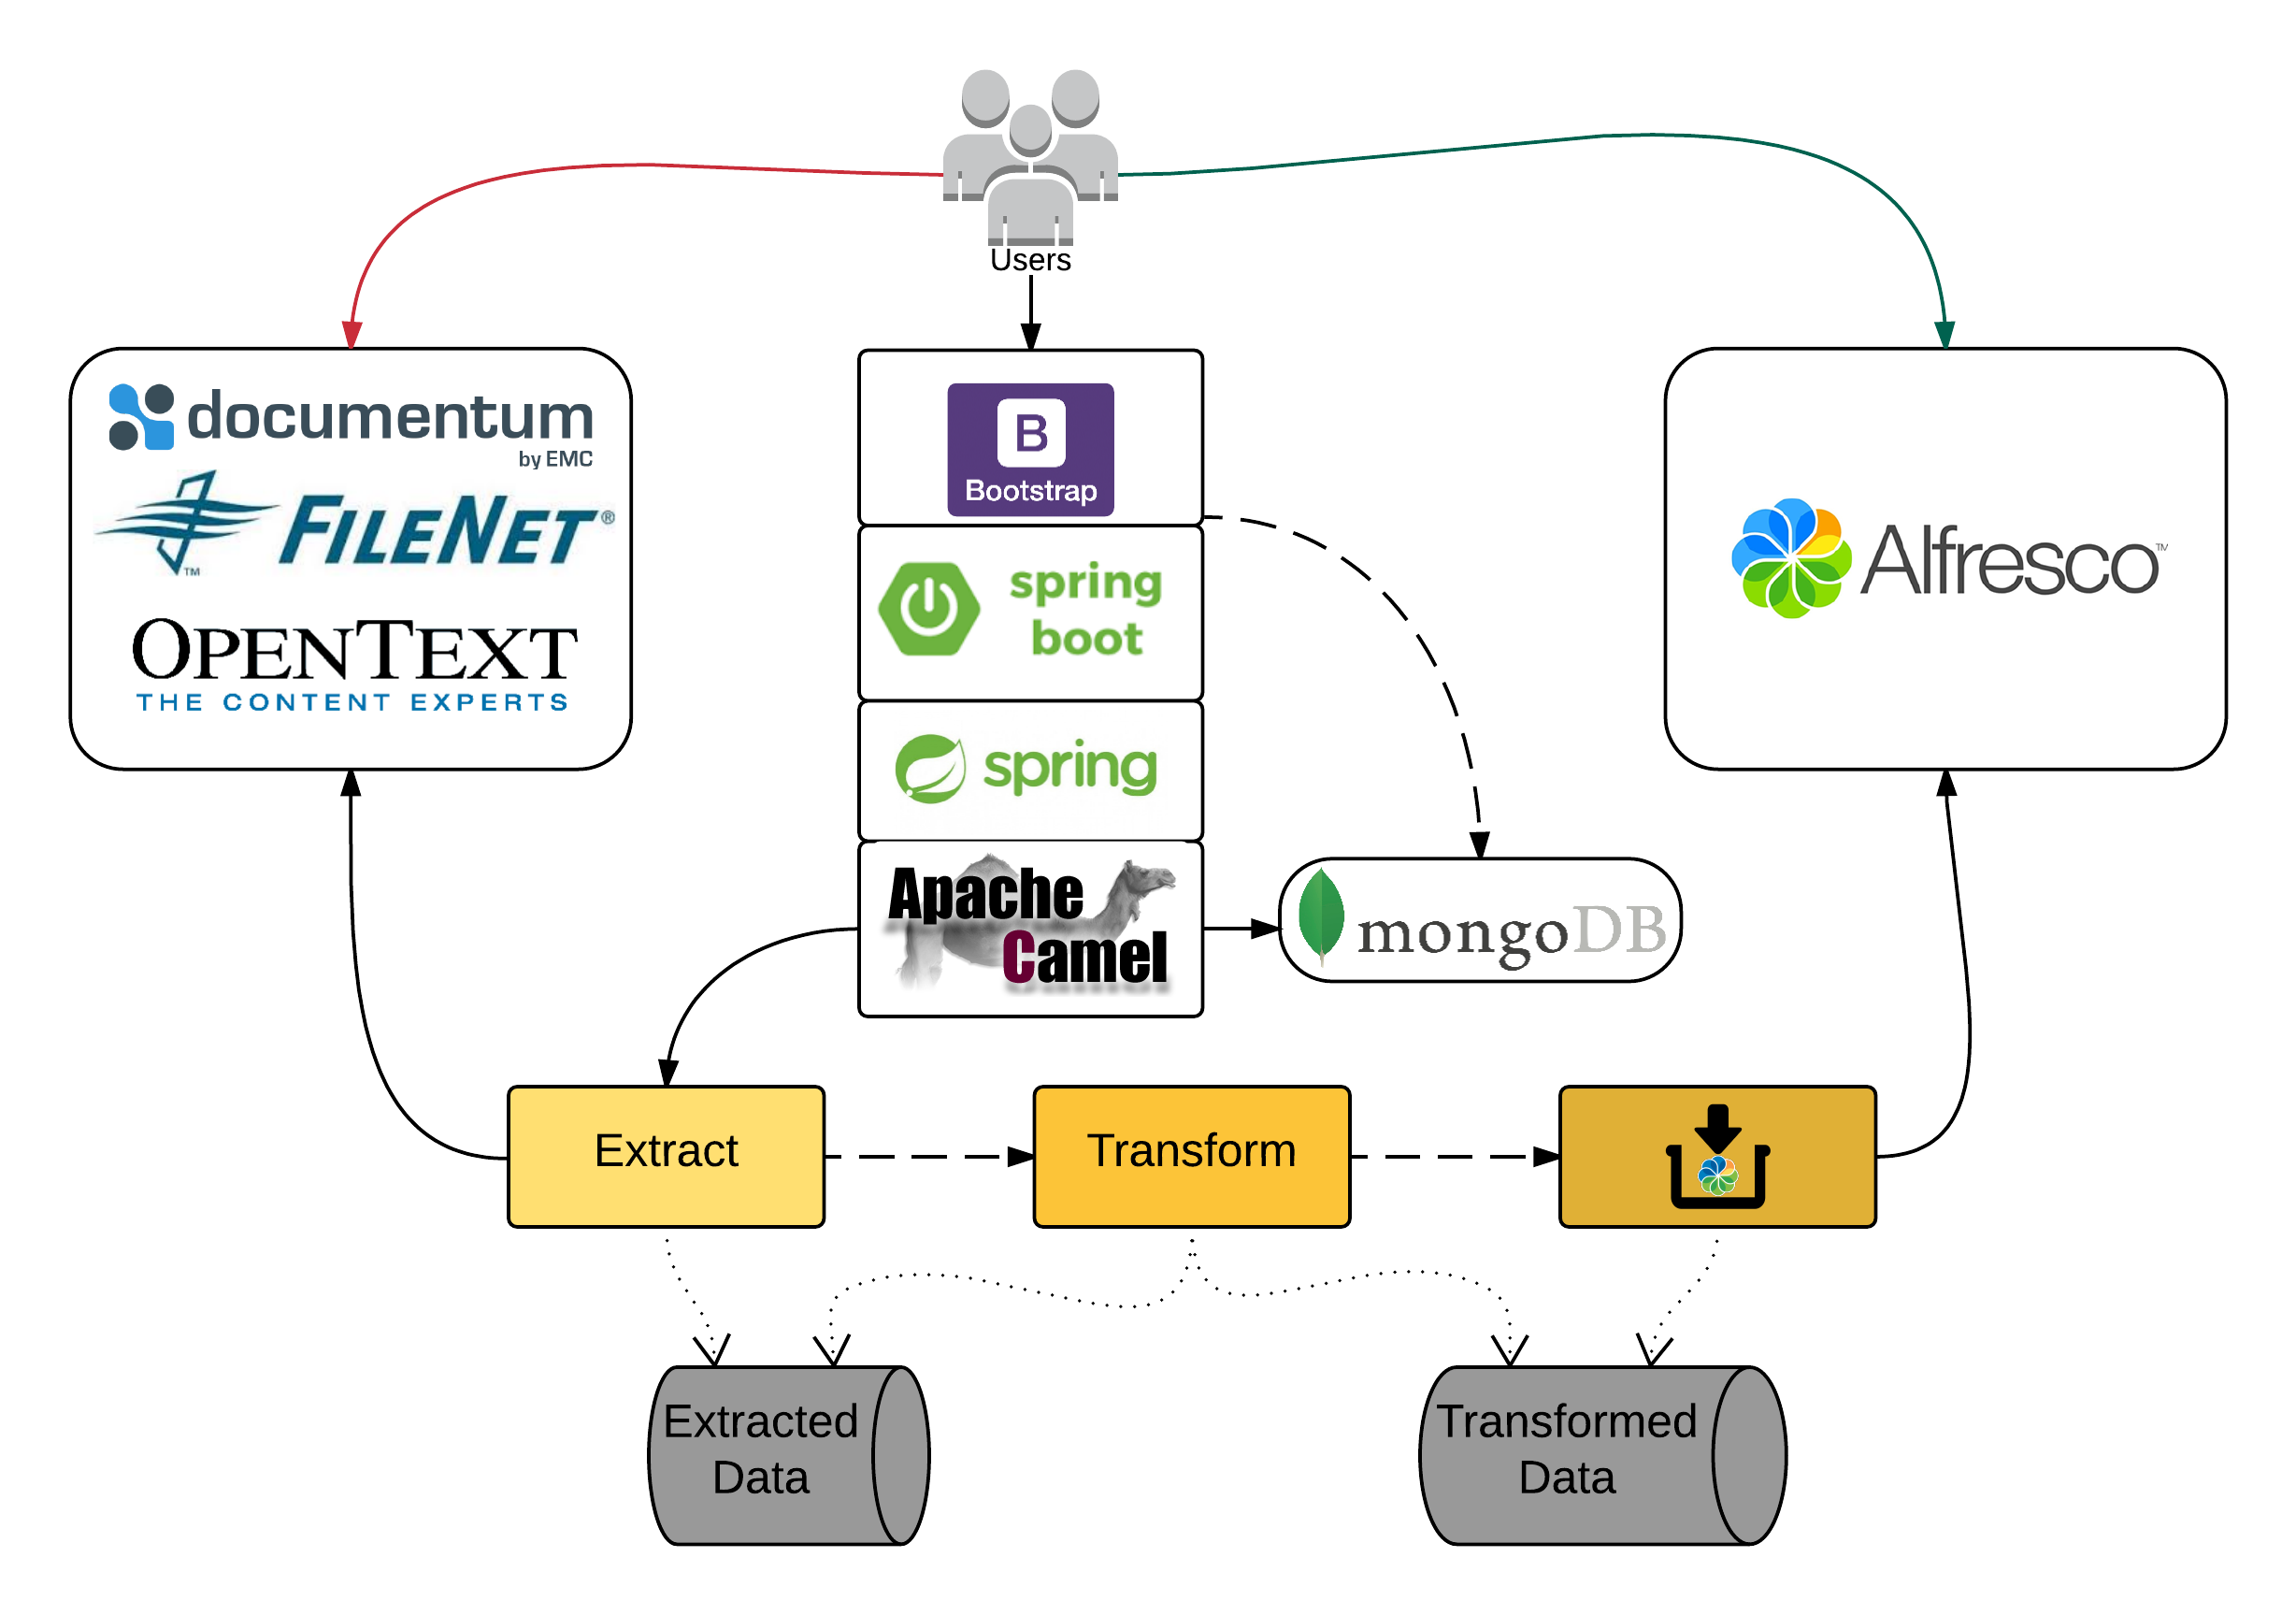
The Whole Picture
Notes:
Explain what is framework and where specific pieces should be put

Slide 28
Conclusion
Take migrations seriously
Distribute duties and responsibilities
Don’t assume it will be perfect
Log any errors you may have
Open Source technology is more than enough
Follow our architectural advice ☺

Slide 29
Improvements
Data streaming for incremental data
Containers and Virtualisation
Notes:
The repetitive parts of the solution

Slide 30
Thank you!
Fran Álvarez
Technical Architect

